Slide 1
Movie Recommendation System
Presented By - Group 3
Group Members
Solome Getachew
Samia MohammedAwol
Timar Tizazu
Shlimat Tadele
Sumaya omar

Slide 2

Section Title
Contents
Introduction
Literature Review
Data Sources
Visualization
Approaches
Requirements
Modeling
File structure
User Interface
Conclusion

Slide 3
Introduction
We are looking to create a movie recommendation system that provides personalized recommendations to all our users. These recommendations are based on their review ratings, preferences, and viewing history. Collaborative filtering will be used to identify recommendations and improve the accuracy of those suggestions.

Slide 4
Literature Review
Movie recommendation systems have evolved significantly, with a wide range of techniques available to cater to diverse user preferences. The combination of collaborative filtering, content-based filtering, hybrid approaches, and deep learning holds promise for further improving the accuracy, diversity, and personalization of movie recommendations.
Despite significant progress, several challenges remain in MRS research. The cold-start problem, where recommendations are difficult for new users or items, requires innovative solutions. Scalability and real-time responsiveness are crucial for handling massive datasets and user interactions. Additionally, addressing biases, ensuring fairness, and incorporating contextual information are emerging areas of research.

Slide 5
Datasource
We got the data from ml-latest-small from https://grouplens.org/datasets/movielens/latest/ dataset. The data contains 100,836 ratings, 3,683 tag applications, and 9,742 movies. The data is kept in 4 different data files.
Ratings Data File Structure (ratings.csv)
Tags Data File Structure (tags.csv)
Movies Data File Structure (movies.csv)
Links Data File Structure (links.csv)

Slide 6
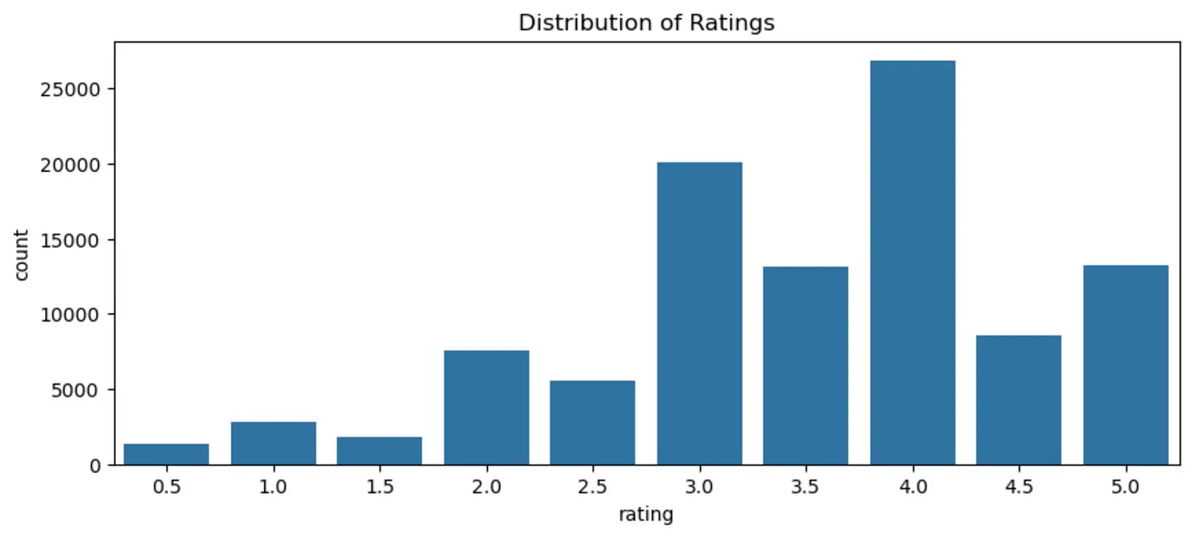
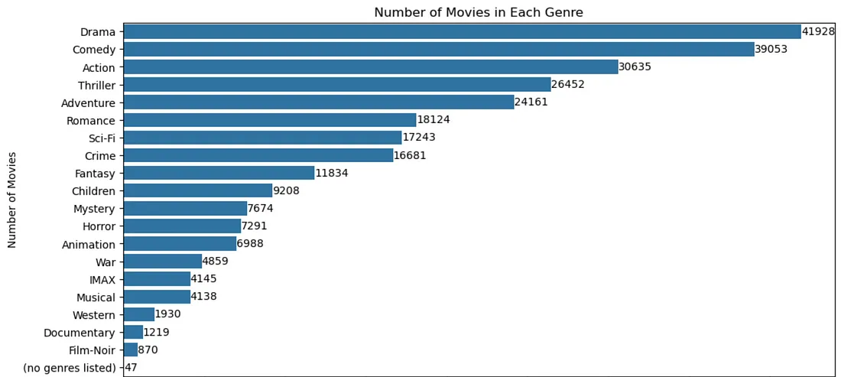
Visualizations
We learned alot about our users and movies. On average movie ratings are scored higher than 3-stars telling us that most viewers consistently enjoy the movies on a baseline. Comedy, Drama, and Action are the most made movies. Sci-Fi shows a big importance to our users based on our Bag of Words. These movies are rated often showing that they get a lot of attention from viewers.

Slide 7
Approaches
Steps:
Data Cleaning
Exploratory Data Analysis
Collaborative filtering
Modeling
The goal is to improve experience by giving their top 20 personalized recommendations based on viewing history, ratings, and activity. Accuracy is an important metric for our predictions. We will use Root Mean Squared Error (RMSE), which is the average difference between predicted values and actual values.

Slide 8
Requirements
Hardware Requirements
Processor: Intel Core i5 or equivalent (or an AMD Ryzen 3)
RAM: 4 GB
Software Requirements
Operating System: Windows 10/11, macOS, or a Linux
Web Browser: Any modern web browser
Python
Jupyter notebook
Flask

Slide 9
Modeling
A . Collaborative Filtering (for registered users
B . Content Based Filtering (for new users

Slide 10
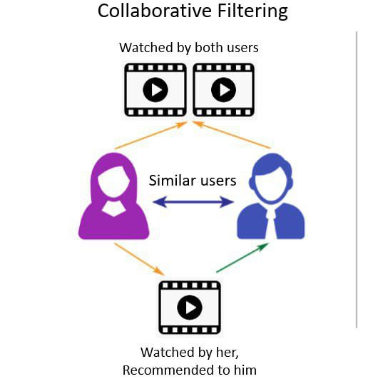
For Registered users(collaborative filtering )
We explored several models.
item-item based model
Collaborative filtering models
Memory Based: K-Nearest Neighbor (KNN)
Model Based: Singular Value Decomposition (SVD)
For the final recommendation model, we used Singular Value Decomposition (SVD). It performed on par with KNN with low RMSE scores (2.8). The benefits for the SVD model is the scalability with big data and the matrix factorization. We can capture more meta data to be utilized in the SVD model going forward to better improve the performance of our recommendations.

Slide 11
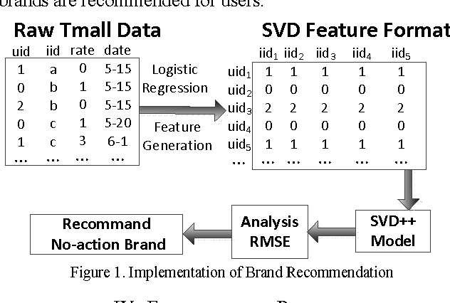
How SVD Works
In a nutshell, Singular Value Decomposition (SVD) in recommendation systems works like this:
User-Item Matrix: It starts with a matrix where rows represent users, columns represent items (e.g., movies), and cells contain ratings or interactions.
Decomposition: SVD breaks down this matrix into three smaller matrices. One represents user characteristics, another represents item characteristics, and the third connects them.
Latent Factors: These smaller matrices reveal hidden patterns or "latent factors" that explain why users like certain items.
Recommendations: By combining the user and item matrices, the system can predict how a user might rate an item they haven't seen, leading to personalized recommendations.

Slide 12
RMSE : 0.2927
The RMSE score of the SVD model on the test set is 0.2927. This indicates that, on average, the model's predictions are about 0.29 units away from the actual user ratings. Given that the ratings are on a scale of 1 to 5, this RMSE suggests that the model is performing quite well.

Slide 13
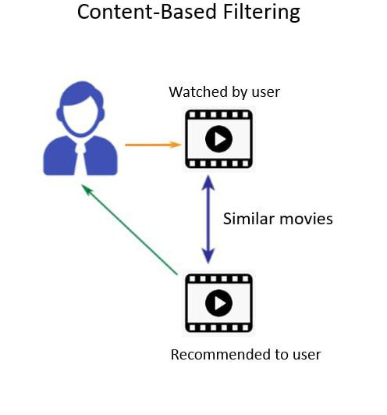
B. For new users (content-based filtering )
This method suggests movies similar to ones the users already like based on their genres.
The system will begin by asking the user to select their favorite genre. Then, it will analyze the ratings provided by other users who share similar preferences and use this information to generate personalized movie recommendations.

Slide 14
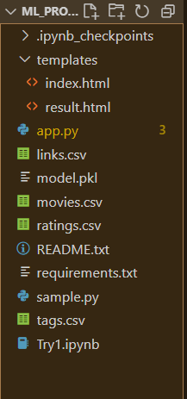
File Structure
Try1.ipynb - This is where the model is trained and tested.
app.py - This is where the interface is built and model is implemented
Index.html , result.html - This are the HTML files
Model.pkl - The model
And other .csv files

Slide 15
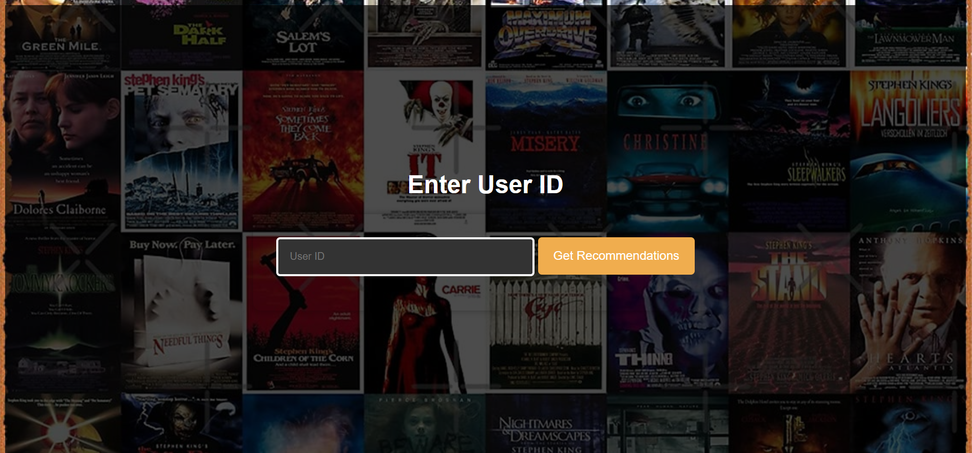
User Interface- Home page

Slide 16
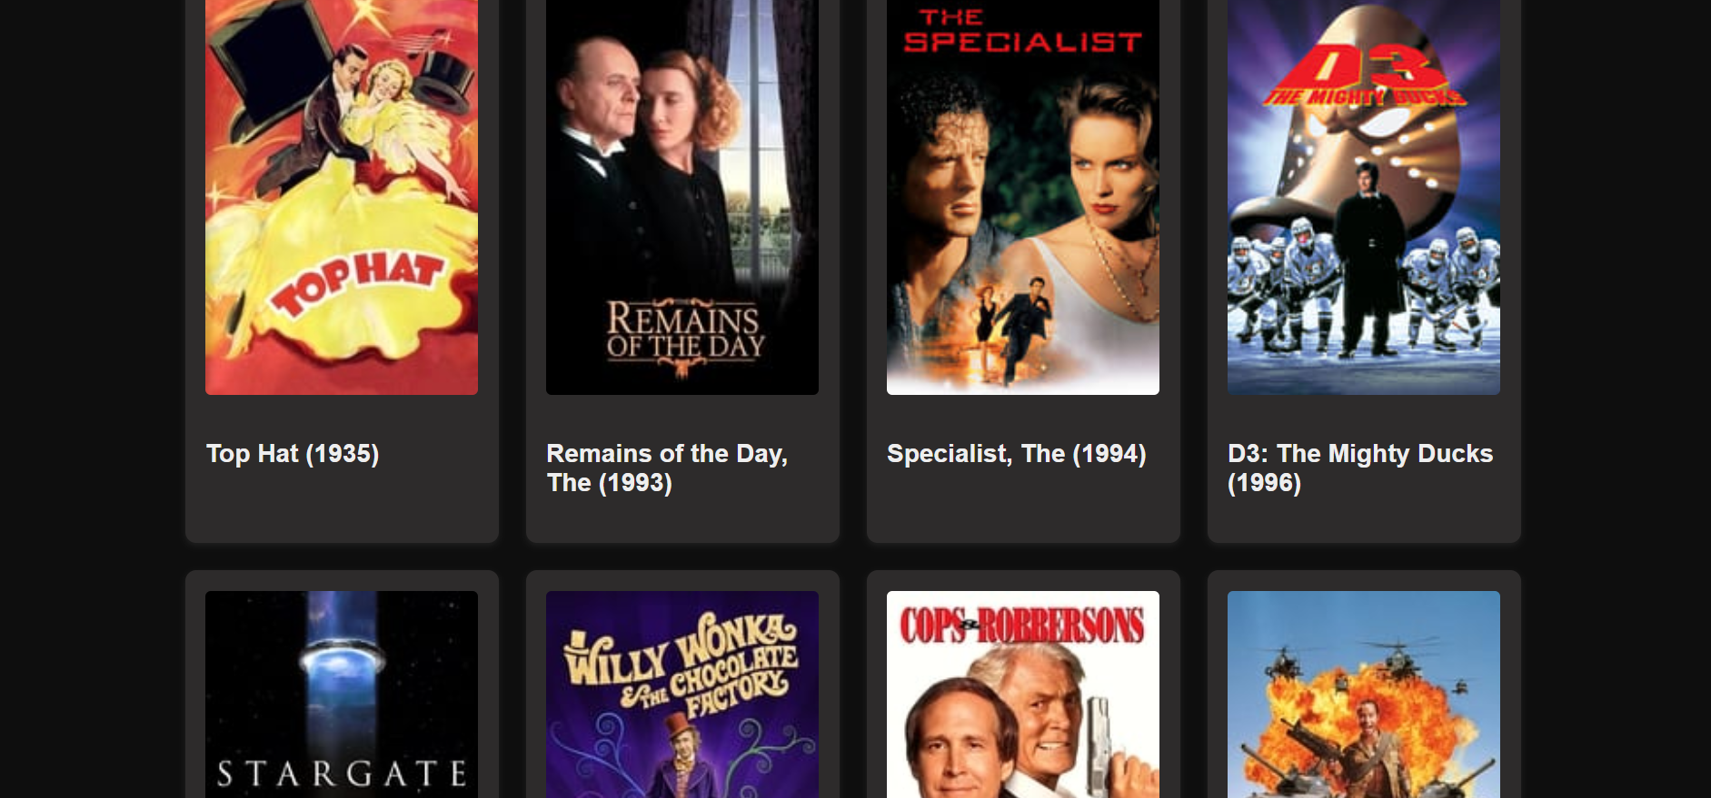
User Interface- Recommendation page

Slide 17
Conclusion
In our effort to build a movie recommendation system, we tested various approaches such as Item-item correlation, Content-Based Filtering using KNN, and a Model-based using SVD. Each approach had its own pros and cons
Its important to consider the trade-offs with each approach. I recommend SVD for scalability and or lightFM with more data. By increasing our data SVD will have more scalability and perform with more accuracy. Light FM will give us the option of exploring user metadata. User-item interactions captured by collaborative filtering will provide diverse and personalized recommendations.

Slide 18
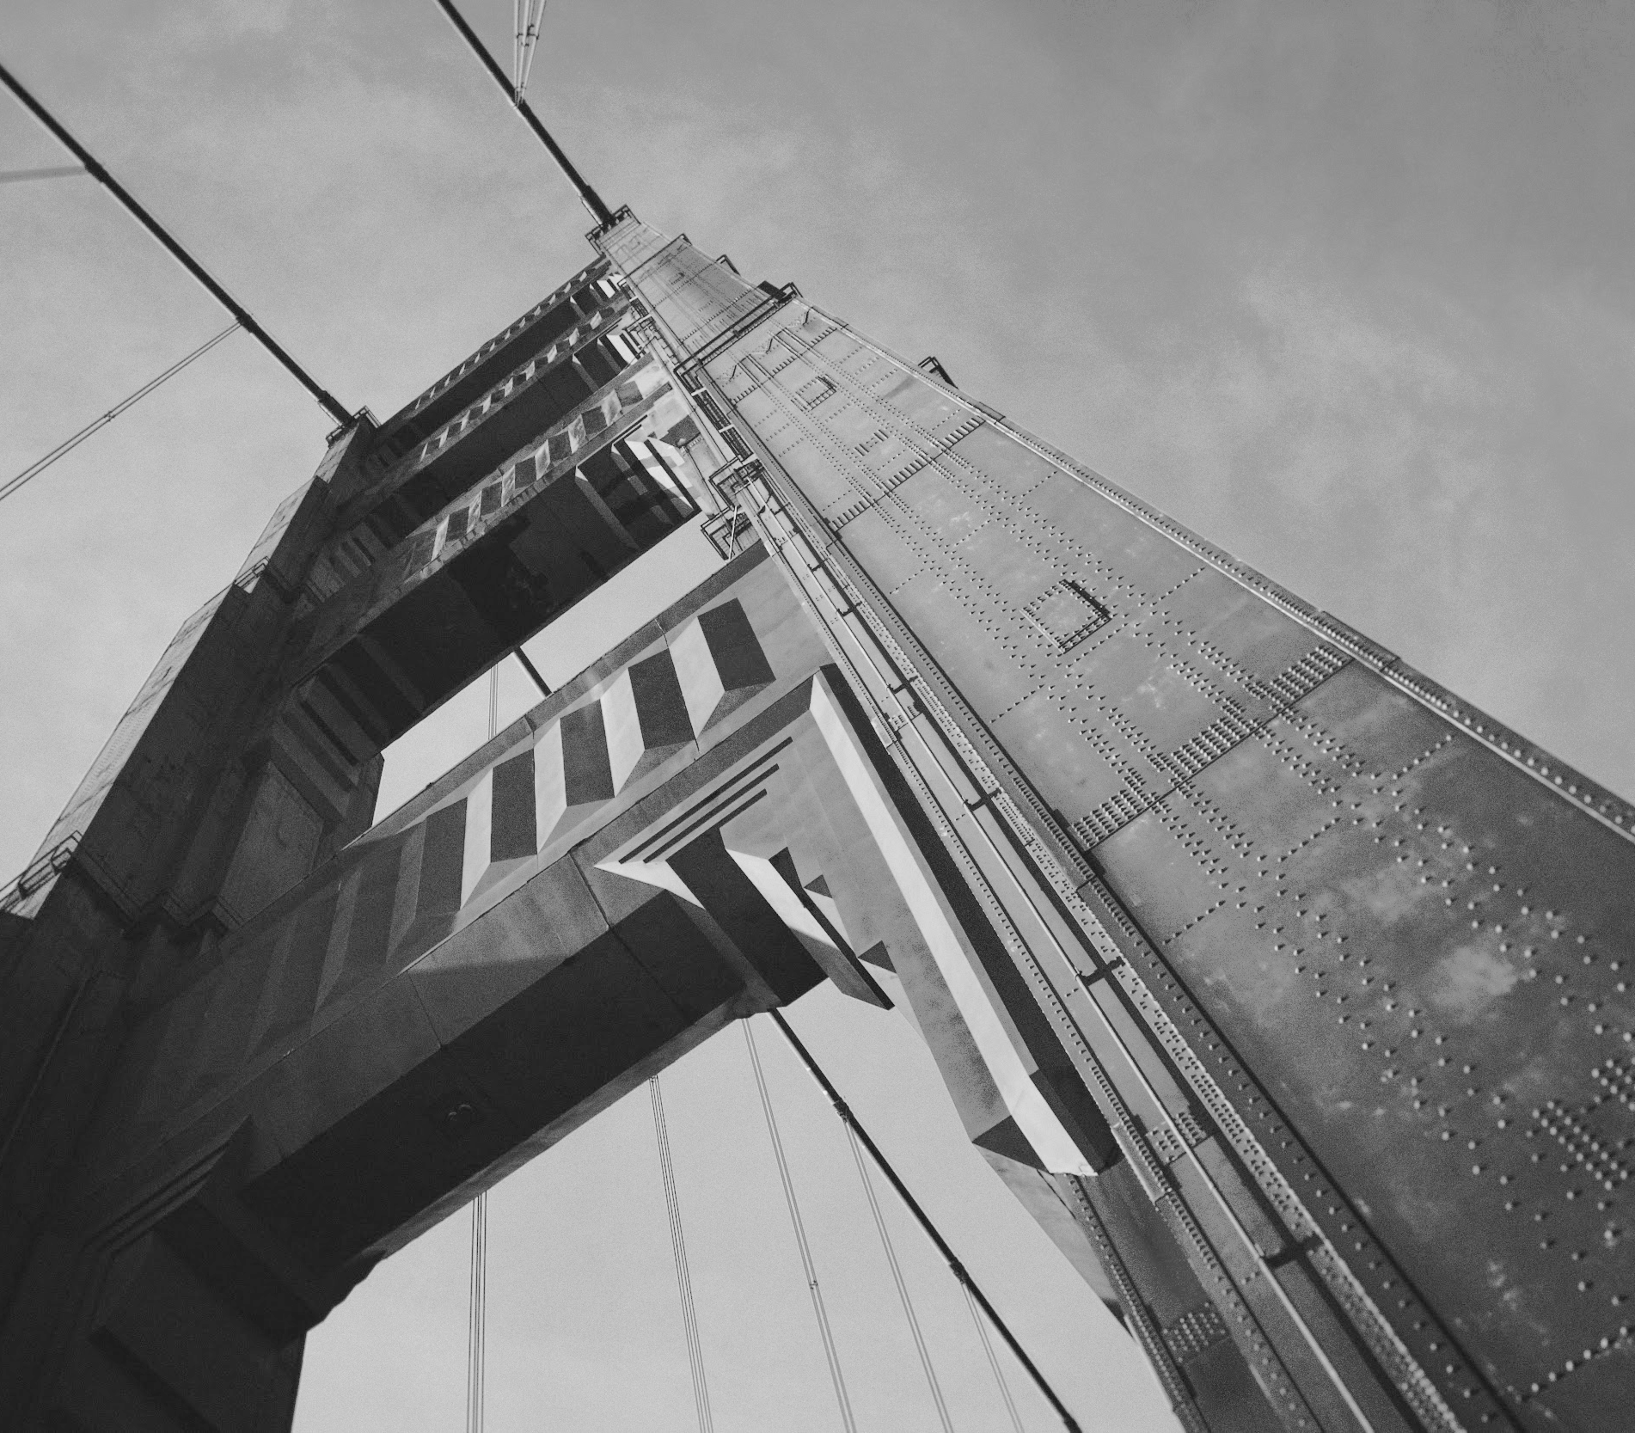

Thanks!

